Slide 1

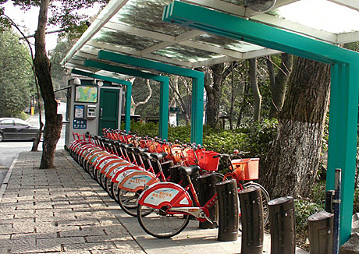

BICYCLE RENTING SYSTEM
Group - 11
Name | ID
Aundrila Paul | 1813375042
Fowzia Farzana | 1921185042
Nahiyan Nazah Ridita | 2012610642
Tasnia Kibria | 2013553642

Slide 2






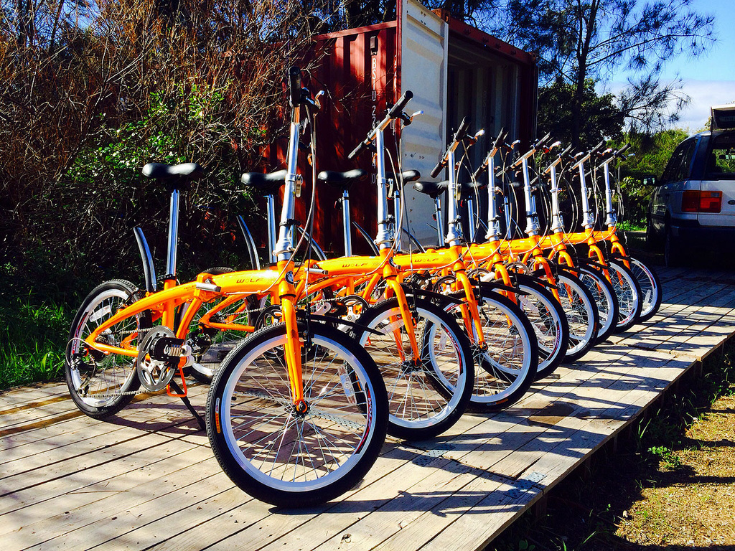
Description
A bicycle renting system is a service that allows individuals to rent bicycles for a specified period of time. It is designed to provide convenient and affordable transportation options for short-distance travel. The process typically involves registering with the rental service, selecting a bicycle from available options, paying the rental fee, and returning the bicycle within the agreed-upon time-frame. This system offers numerous benefits, including promoting sustainable transportation, reducing traffic congestion and pollution, improving health and fitness, and providing an alternative mode of transportation in crowded urban areas.

Slide 3





Target Market
The target audience of this system is the young generation/students and workers. Additionally, the people who like cycling but don’t have their own bicycles is the target as well .
Bicycle Renting
System

Slide 4

Requirements and
Challenges
In our country each and every day students/workers have to go through the commute, transportation and traffic problems. So this system offers a service where customers can rent bicycles for per-hour, per-day, per-week usage.
Bicycle Renting System can help students/workers to go to their study or workplace fast and easily at a very low cost.

Slide 5

Functionality
View available bicycles
Registration
View Bicycle
Add bicycle
This process requires user name, NID card number and picture, mobile number, address and user password. After submitting all the required information the new user must wait for admin approval.
A user can view all the bicycles with related information such as pictures, rental hours, cost per hour, location, owner name, rating etc. user can search bicycles with location, rental hours and rating.
Add/remove/update
Registered users can add their bicycles for rent. Bicycle owner can remove his bicycle if he no longer wants to give it on rent.
Registration
Cancellation
Booking
Cancellation
Tracking
Booking
User can cancel a reservation within 5 hours after confirming the bicycle reservation. This will return the amount paid for booking to the user.
During the rental period time countdown will start and bicycle owner can track the location of the bicycle. Extra charge will be added if the user returns the bicycle after the reservation hours.
Users can select any non-reserved bicycle from any owner. For confirming the bicycle reservation, users need to specify a reservation time slot and must pay the rental charge. The status of bicycle will be updated as soon as it gets free or it gets booked.

Slide 6
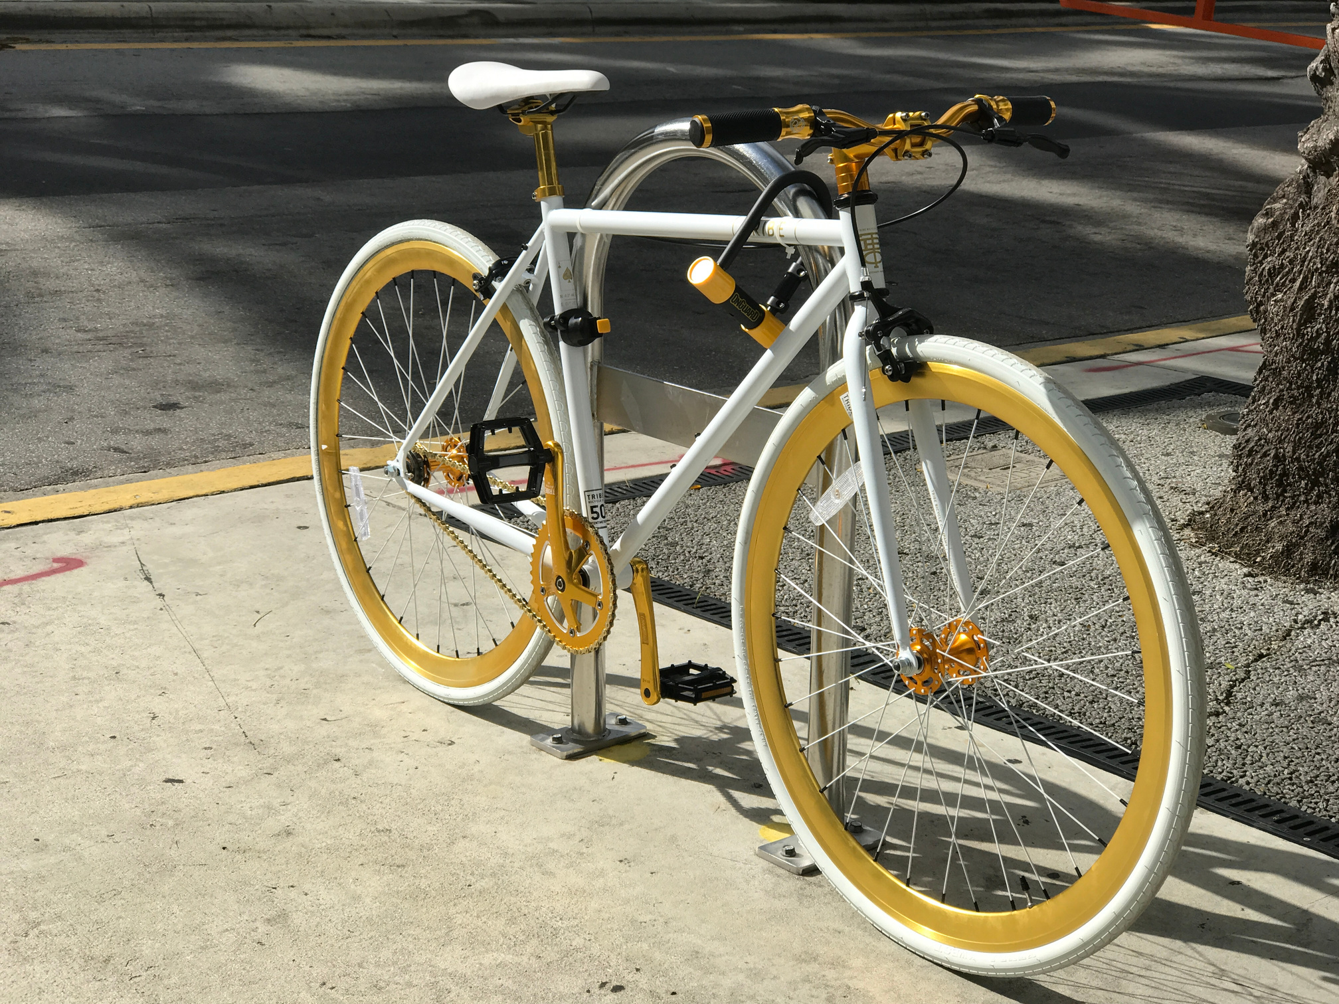
THANK YOU

